Slide 1
WINE QUALITY PREDICTION
Reetu – 13th MAY Batch

Slide 2
Agenda
Objective
Data Description
Data Analysis
Insights

Slide 3
Objective
To predict the wine quality using machine learning through Python.
To analyse a large dataset consisting different wine parameters to model the wine quality
Analysing through Random Forest classifier Algorithm to rate the wine as good or bad
Output will be checked for correctness and model will be optimized accordingly to improve the production.

Slide 4
Data Description
The Quality prediction dataset have 1599 rows and 12 columns depicting 11 Independent characteristics and 1 Dependent characteristic.
Total 12 characteristics are –
Dependent Variable(1)
Quality | Wine quality measured on 1 – 10 scale

Slide 5
Independent Variables (11)
Fixed acidity | Primary fixed acids found in wine are tartaric, succinic, citric, and malic
Volatile acidity | Gaseous acids present in wine
Citric acid | Weak organic acid, found in citrus fruits naturally
Residual sugar | Amount of sugar left after fermentation
Chlorides | Amount of salt present in wine
Free sulfur dioxide | No. of grams of free sulphites per dm3 of wine
Total sulfur dioxide | No. of grams of total sulphites
Density | Density in gram per cm3
pH | To measure ripeness
Sulphates | Added sulfites to protect wine from oxidation and bacteria
Alcohal | % of alcohol present in wine.

Slide 6
Data Analysis
Algorithm used - Random Forest classifier

Slide 7
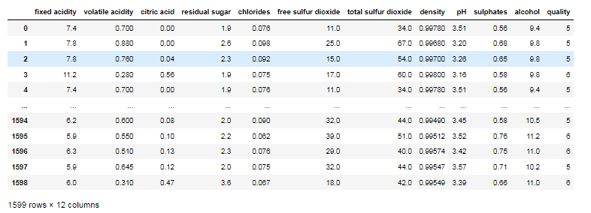
Reading and loading the dataset to do the data analysis -
Wine quality prediction by using the large Wine dataset with all the 1599 rows and 12 columns on which analysis has to be done to predict the quality of Wine.

Slide 8
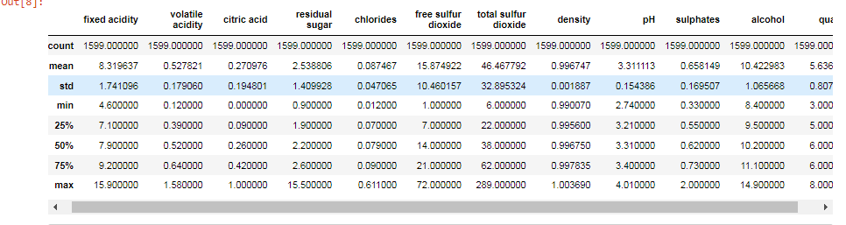
Getting 5 number summary details of the complete datset

Slide 9
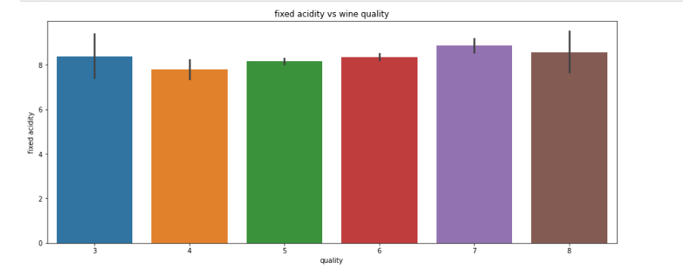
Distribution of all the data columns with the target variable (Quality) using barplot for showing that how the data columns are distributed in dataset.
Fixed acidity vs Wine quality
No proper clarification of fixed acidity with quality of wine is identified

Slide 10
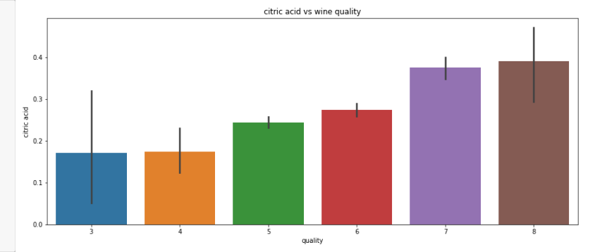
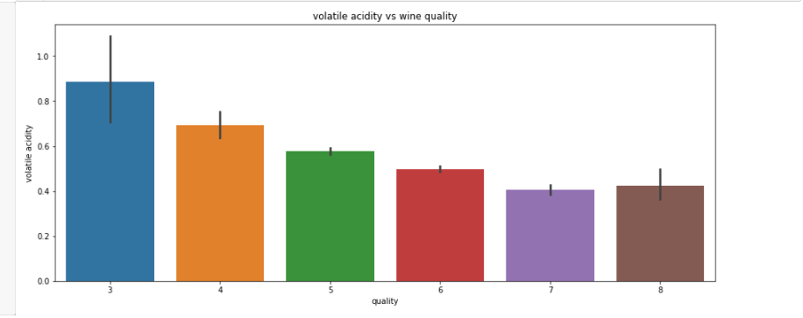
Citric acidity vs Wine quality
The quality of wine is going higher as the level of citric acid level goes up
The quality of the wine is increasing with decreasing level of volatile acidity
Volatile acidity vs Wine quality

Slide 11
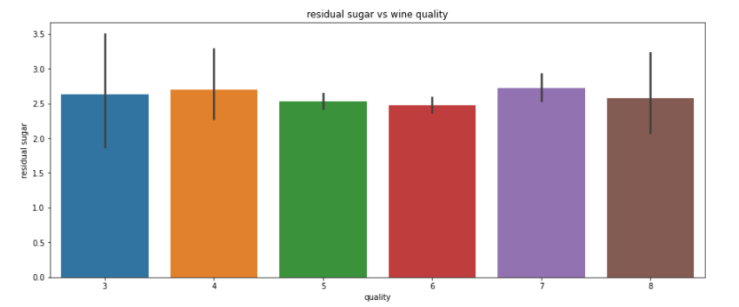
Residual sugar vs Wine quality
No proper clarification of residual sugar with quality of wine is identified

Slide 12
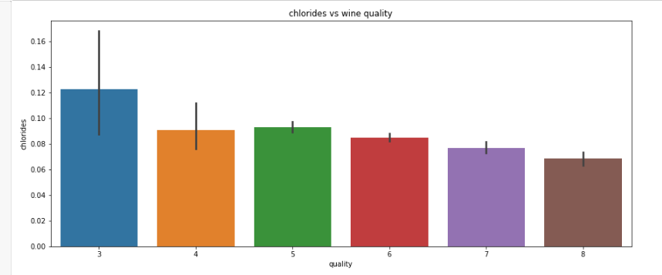
Chlorides vs Wine quality
The quality of the wine is rising when the quantity of chloride going down

Slide 13
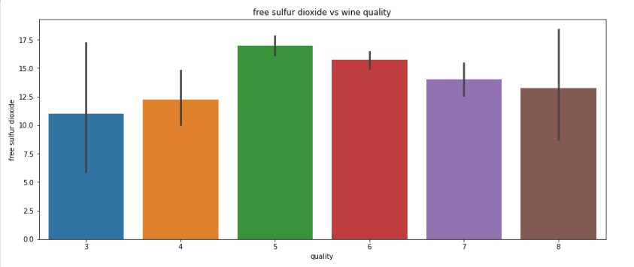
Free sulphur dioxide vs Wine quality
No proper clarification of free sulfur dioxide with quality of wine is identified

Slide 14
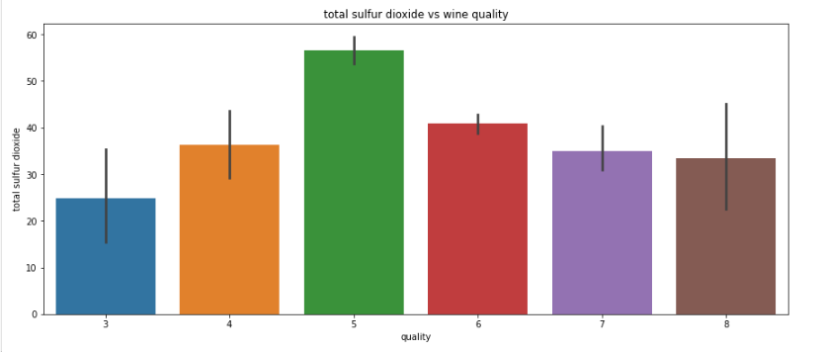
Total sulphur dioxide vs Wine quality
No proper clarification of total sulfur dioxide with quality of wine is identified

Slide 15
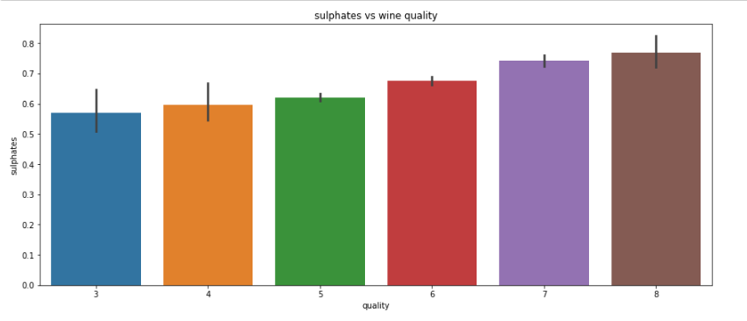
Sulphates vs Wine quality
The quality of wine is improving as the level of sulphates goes up

Slide 16
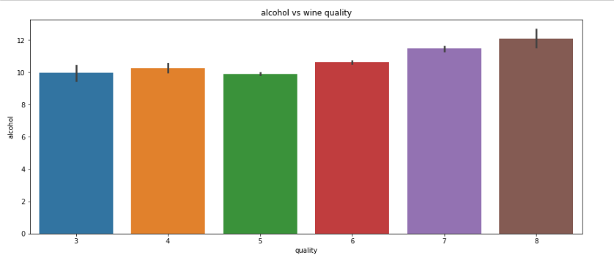
Alcohal vs Wine quality
The quality of wine is improving as % of alcohol is increasing

Slide 17
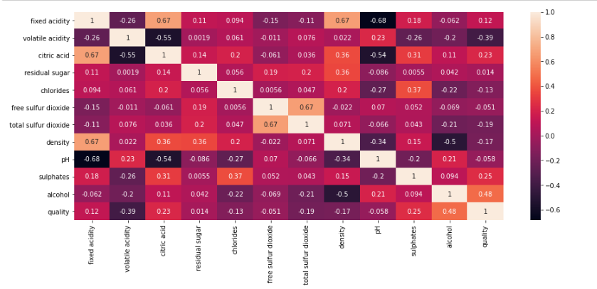
Correlation matrix
This correlation matrix explains about the correlation of all the wine characteristics with each other
The Correlation matrix also provides information on independent variables which are strongly/weakly correlated with target variable

Slide 18
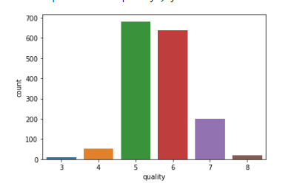
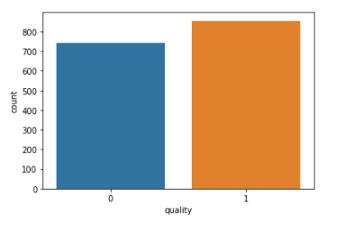
Count of records based on the wine quality level 1-10
Subsets the data count based on good (6,7,8) quality as 1 and bad quality (3,4,5) as 0

Slide 19
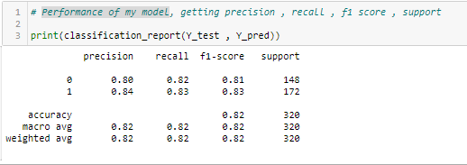
Performance of my model (Classification Report)
Applied RandomForestClassifier for checking the accuracy score and
the accuracy score of RandomForestClassifier is 82% so this model predicts the quality of wine with an accuracy of 88%.

Slide 20
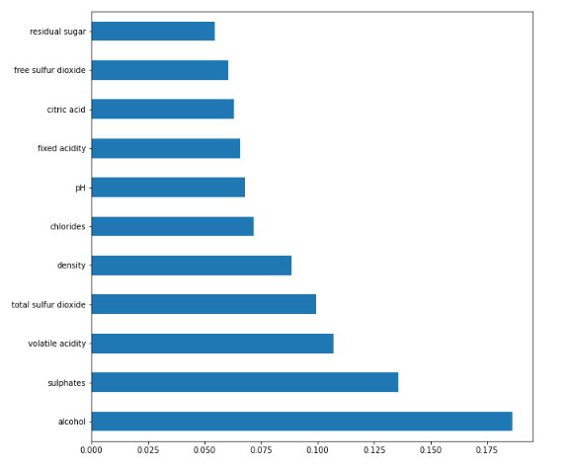
Variable Importance graph
Data Modelling is done on training data and testind data to predict the wine quality
Graph explains the importance of the parameters with respect to the wine quality based on Random Forest Algorithm

Slide 21
Insights
As per the analysis, Good quality wines have higher levels of alcohol and sulphates.
Volatile acidity,total sulphur dioxide and density should be on average levels for better quality of wine.
Remaining parameters should be kept at low level for good quailty of wine.

